Slide 1


Image segmentation:
Point, Line and Edge detection Template Matching
Presented by:
Sd.Md.Sameer(21bce8463)
vivek vardhan(21bce9558)
Boda Venkatesh (21BCE9463)
Dasari Gunatej Utham (21BCE9564)

Slide 2

Image Segmentation: Point, Line, and Edge Detection
Image segmentation is a crucial step in image processing, where an image is divided into meaningful regions or objects. This is essential for tasks like object recognition, tracking, and scene understanding.
Three fundamental techniques in image segmentation include point detection, line detection, and edge detection:
Point Detection: Identifies distinct points in an image (like corners). Useful in tasks like object detection and 3D modeling.
Line Detection: Finds straight lines or curves in an image. Essential for detecting structures, roads, or text lines.
Edge Detection: Detects boundaries between different regions in an image. Crucial for identifying shapes, objects, and segmenting the image.

Slide 3

Template Matching: Template matching Compares a small image (template) to a larger image to find matches. It is Used for finding specific objects or patterns (like faces or logos) in an image.
Types of Grey Level Discontinuties
Point
Line
Edge
ISOLATED POINT
HORIZONTAL LINE
OBJECT OUTLINE
VERTICAL LINE
SLANTED LINE

Slide 4
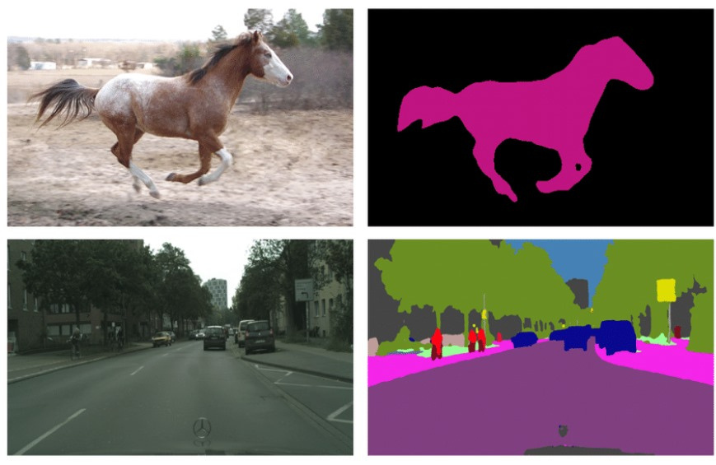
How they are used in image processing?
1. Image Segmentation
Purpose: Image segmentation divides an image into meaningful regions or segments, making it easier to analyze and understand.

Slide 5
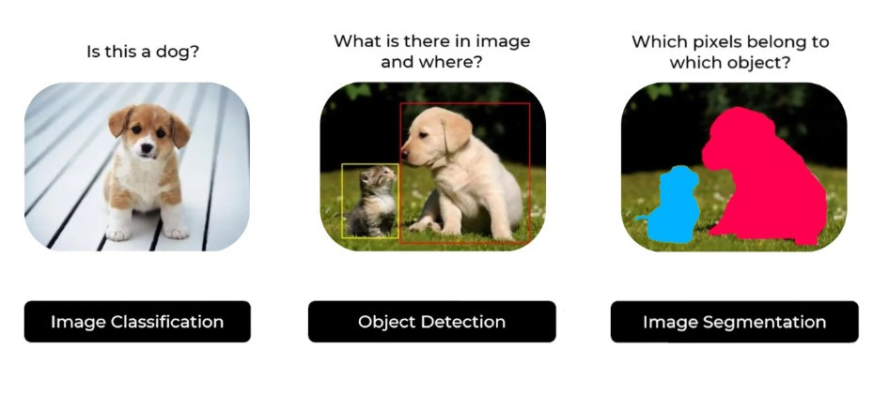
How its used:
Object Recognition: Segmenting an image into different objects or regions helps in identifying and classifying them.
Video Surveillance: Identifying and tracking moving objects or people within video frames.
Autonomous Vehicles: Segmenting road lanes, pedestrians, and other vehicles to aid navigation.

Slide 6
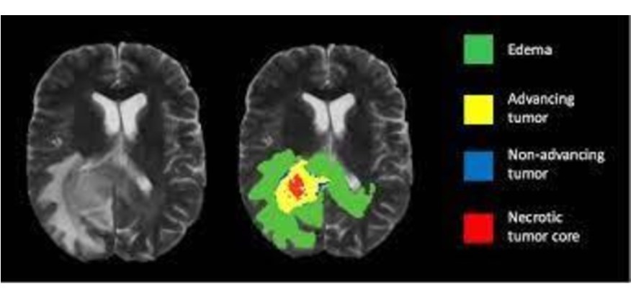
Medical Imaging: Segmenting organs or tumors from medical scans (e.g., MRI, CT) for diagnosis and treatment planning.
Techniques:
Thresholding: Separates objects based on pixel intensity. Simple but effective for images with clear contrast.
Clustering: Groups pixels with similar colors or intensities. For example, k-means clustering.

Slide 7
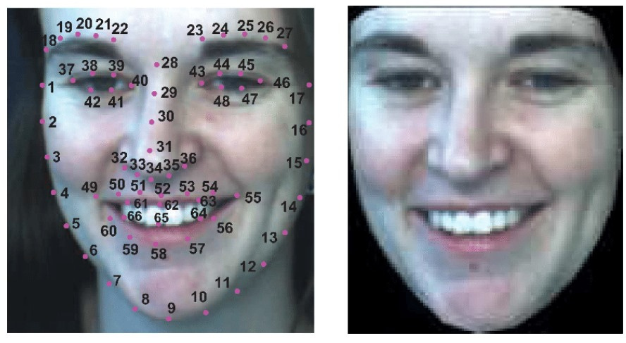
2. Point Detection
Purpose: Detecting distinct points or features in an image, which can serve as reference points for further processing.
How It’s Used:
Tracking: Following the movement of specific points over time in video sequences.
Calibration: Finding calibration points in camera calibration or 3D reconstruction tasks.

Slide 8
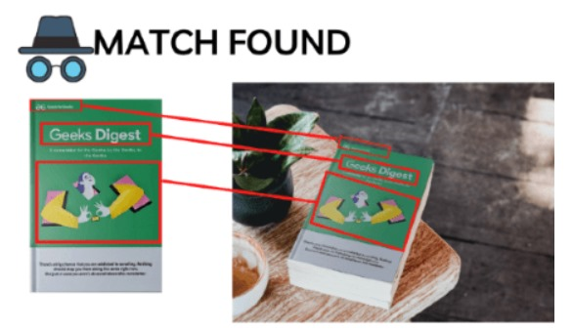
Feature Matching: Identifying and matching key points between images for tasks like image stitching or object recognition.
Techniques:
Harris Corner Detector: Finds points where the image intensity changes significantly in multiple directions.
Shi-Tomasi Detector: An improvement on the Harris detector for finding good features to track.

Slide 9
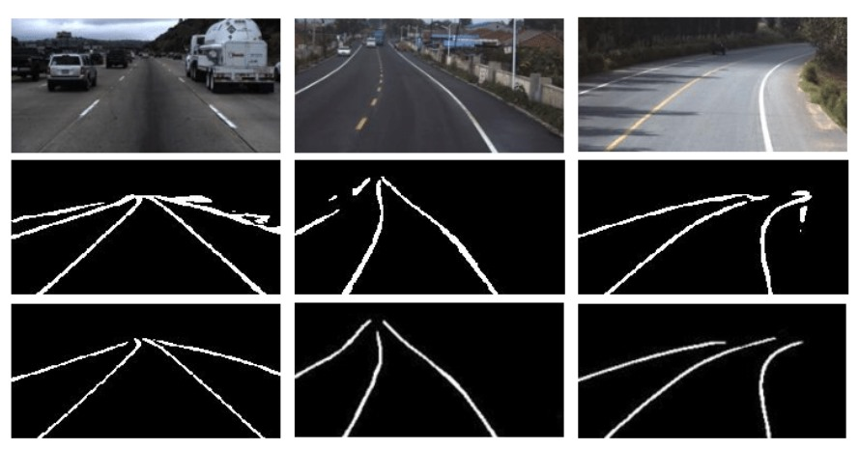
3. Line Detection
Purpose: Identifying straight lines in images, useful for understanding geometric structures and patterns.
How It’s Used:
Geometric Analysis: Detecting lines for applications like lane detection in autonomous vehicles.

Slide 10
Document Analysis: Identifying lines in scanned documents to detect text or tables.
Architectural Analysis: Analyzing building structures or floor plans
Techniques:
Hough Transform: A method that detects lines by transforming points in the image into a parameter space to find lines.
Probabilistic Hough Transform: A variant that uses a randomized approach to detect lines more efficiently.

Slide 11
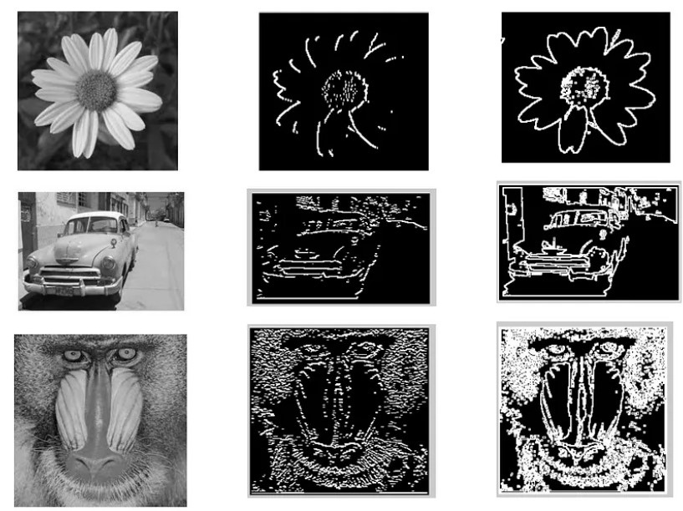
4. Edge Detection
Purpose: Detecting the boundaries between different regions in an image, which is crucial for understanding object shapes and structures.

Slide 12
How It’s Used:
Object Recognition: Identifying object boundaries to help in object detection and classification.
Image Enhancement: Highlighting edges to enhance features or for further image processing.
Medical Imaging: Detecting boundaries of organs or abnormalities.
Techniques:
Canny Edge Detector: An edge detection algorithm that uses a multi-stage process to identify edges with high accuracy.
Sobel Operator: Detects edges by calculating gradients in the image.
Prewitt Operator: Similar to Sobel but uses different convolution kernels.

Slide 13
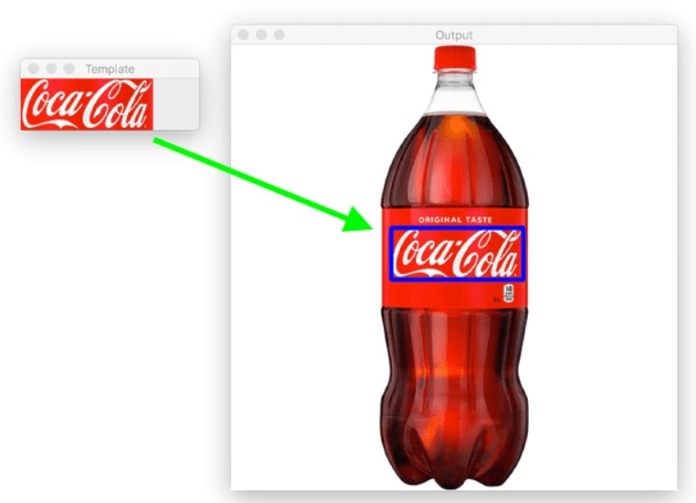
5. Template Matching
Purpose: Finding regions in an image that match a predefined template, useful for object detection and localization.

Slide 14
How It’s Used:
Object Detection: Identifying and locating objects within an image by matching them with a template.
Quality Control: Checking for defects or discrepancies in manufacturing by matching parts with templates.
Face Recognition: Matching face templates to recognize individuals in images or video streams.
Techniques:
Cross-Correlation: Measures similarity between the template and the image using correlation.
Normalized Cross-Correlation: Adjusts for changes in brightness and contrast to improve matching accuracy.

Slide 15
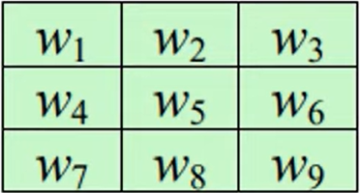
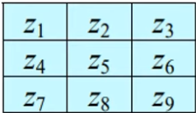
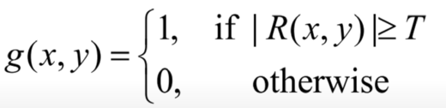
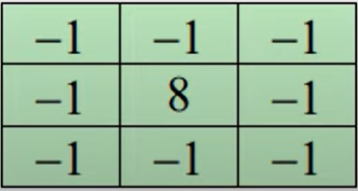
POINT DETECTION
An isolated point is a point whose grey level is significantly different from its background in a homogeneous area.
Steps for point detection:
Apply Lalacian filter to the image to obtain R(x,y).
Create binary image by threshold
Mask
Image
where, T is anon negative integer.
Sample mask for Point Detection

Slide 16
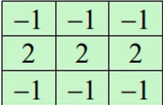
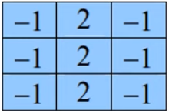
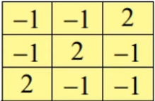
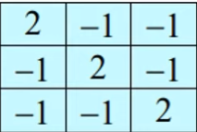
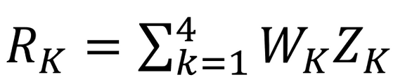
LINE DETECTION
In a line detection four types of masks are used to get the response, i.e, R1, R2,R3, R4 for the directions vertical horizontal, +45 degrees, -45 degrees.
≠
Horizontal
Vertical
+45 degree
-45 degree
Response of a mask:
If, at a certain point in the image, |Ri| > |Rj| for all j≠i, that point is said to be more likely associated with a line in the direction.

Slide 17

EDGE DETECTION
An edge is a set of connected pixels that lies on the boundary between two regions which differ in grey value. Pixels on edge is known as edge points.
Edges provide an outline of the object
In physical plane, edge corresponds to the discontinuities in depth, Surface orientation, change in material properties, light variations etc.
It locates sharp changes in the intensity function.
Edges are pixels where brightness changes abruptly.
An edge can be extracted by computing the derivative of the image function
Magnitude of the derivative, indicates the strength or contrast of edge
Direction of the derivative vector, indicates the edge orientation

Slide 18





EDGE DETECTION
Some of the Commonly encountered edges in image processing are:
Step Edge
Ramp Edge
Spike Edge
Roof Edge
An abrupt change in intensity
A slow and gradual change in intensity
Quick change or immediately returns to original intensity level
It is not instantaneous over short distance

Slide 19
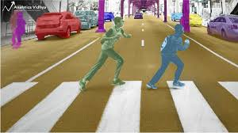
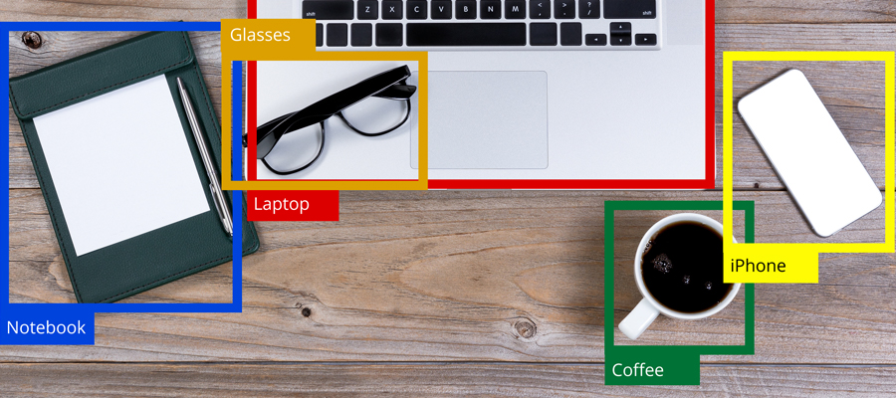
Advantages:
1. Image Segmentation
Simplifies Analysis: By dividing an image into segments, it reduces complexity, making it easier to analyze and interpret individual regions.
Facilitates Object Identification: Makes it easier to identify and classify objects by isolating them from the background or other objects.
Enhances Performance: Increases the efficiency of algorithms by reducing the amount of data to be processed.

Slide 20
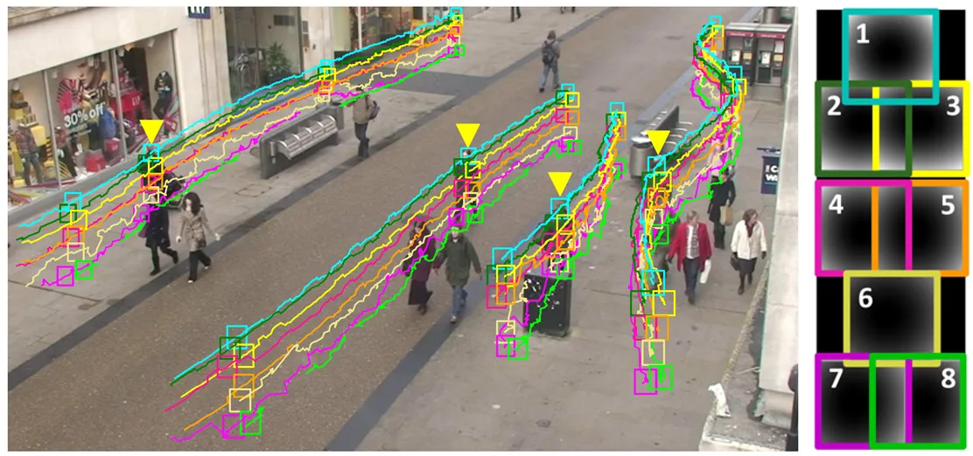
2. Point Detection
Advantage:
Robust Feature Identification: Detects distinctive points or features, such as corners, which are invariant to changes in scale and rotation, providing stable reference points.
Critical for Tracking: Essential for tracking objects or features across frames in video sequences or different images.

Slide 21
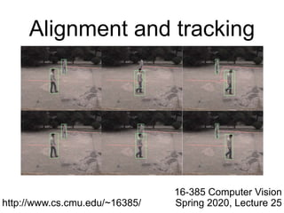
3. Line Detection
Advantages:
Structural Analysis: Useful for identifying and analyzing straight-line structures within an image, which is important for understanding geometric shapes and patterns.
Facilitates Image Alignment: Useful in aligning and stitching images based on detected linear features.

Slide 22

4. Edge Detection
Advantages:
Highlights Boundaries: Effectively identifies the boundaries and contours of objects, which is crucial for recognizing shapes and structures.
Improves Image Quality: Can be used for noise reduction and enhancing the quality of images by emphasizing important features.

Slide 23
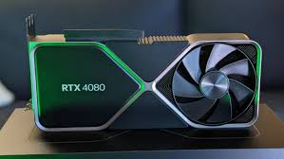
Dis-advantages:
1. Image Segmentation
High Computational Needs:
Data Requirements:
Evaluation Challenges:

Slide 24
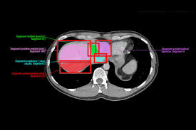
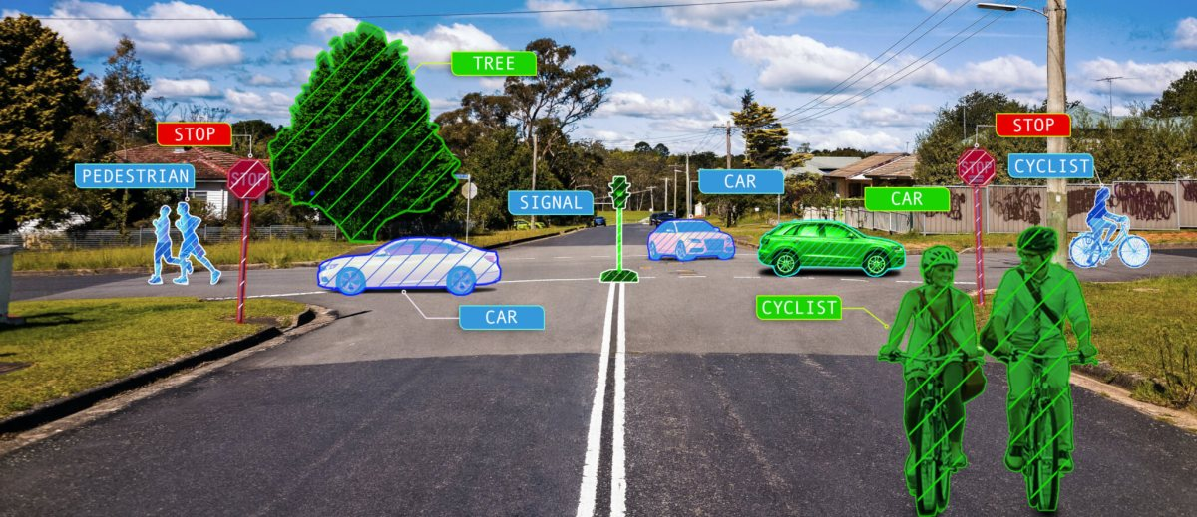
Industry usage examples
Medical Imaging:
Manufacturing and Quality Control:
Autonomous Vehicles:

